Slide 1
EEar
Nick Van Lieshout, Garrett Dougherty, Gina Gilmartin, Kyle Wisbrock

Slide 2
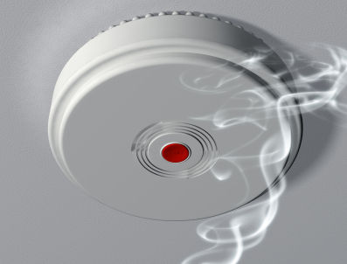
Introduction

Slide 3
Problem Description
Deaf people need a way to be informed when various alarms go off in their homes that alert them without using sound.

Slide 4
Proposed Solution
We intend to make a wristband that communicates with all of the alarm systems in a home, such as smoke alarm, carbon monoxide detector, and intruder alarm for front and back doors.

Slide 5
Demonstrated Features
Wristband
Color LEDs
LCD display
Vibration
Clear/reset button
Wireless communication
User programmability
Sensor
Wireless communication
Module to attach to various alarms
User programmability

Slide 6
Available Technologies
LEDs
Wi-Fi transmitter/receiver
Rechargeable battery cell
LCD display
Buzzer
Microprocessor
Serial port micro USB connector
Push button

Slide 7
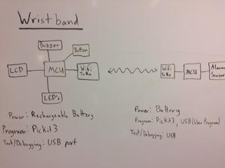
Engineering Content

Slide 8
Conclusion
Our project solves a fundamental problem affecting countless people around the world.

